Slide 1
Thursday, 12/12/2024
Computer Science, FAST NUCES
PalmSecure Revolutionizing Transport with Biometric Precision
GROUP MEMBERS
SUPERVISOR
Muhammad Talha Bilal (K21-3349)
Muhammad Hamza (K21-4579)
Muhammad Salar (K21-4619)
Dr. Muhammad Atif Tahir

Slide 2
Table of Contents
Computer Science, FAST NUCES
pg.
I
Introduction
3
II
Literature Review
5
III
Methodology
7
IV
Results
12
V
Conclusion & Discussions
17

Slide 3
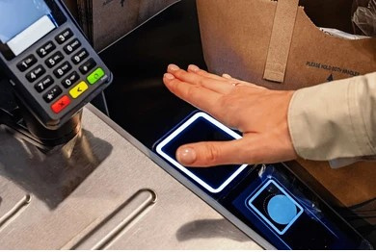
I. Introduction
Computer Science, FAST NUCES
Existing transportation biometric systems are vulnerable to environmental factors, health risks, and accuracy limitations, requiring complex hardware compromising security, efficiency, and revenue. A robust, accurate, and hygienic solution is urgently needed.
Security breaches and unauthorized access in transport.
Passenger safety concerns.
Inefficient identity verification systems
3

Slide 4
I. Introduction
Computer Science, FAST NUCES
Objective
Challenges in the Transport Industry
To develop a palmprint verification system tailored for the transport industry using biometric and deep learning technologies.
Security vulnerabilities in current biometric systems
Environmental sensitivity of facial and fingerprint recognition
Health concerns due to contact-based methods
Accuracy limitations under diverse conditions​​
5

Slide 5
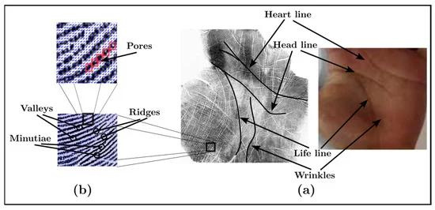
II. Literature Review
Computer Science, FAST NUCES
Why Comprehensive Coordination Mechanism?
Extracts multi-order texture and spatial features
Overcomes limitations of other biometric methods
Fig 2: https://www.sciencedirect.com/science/article/pii/S0031320304001001
6

Slide 6
II. Literature Review
Computer Science, FAST NUCES
Why Comprehensive Coordination Mechanism?
Robust Feature Extraction: extracts multi-order texture and spatial features, providing a more comprehensive representation of palmprint images.
Improved Generalizability: eliminates the need for class labels or pre-trained filters, enhancing its ability to generalize to unseen data.
Improved Robustness: provides robust feature extraction mechanisms, improving recognition accuracy and robustness against environmental factors.
Non-Contact and Hygienic: supports touchless palmprint recognition, offering a non-contact and hygienic solution.
Scalability: CCM's efficient architecture allows for scalable deployment
10

Slide 7
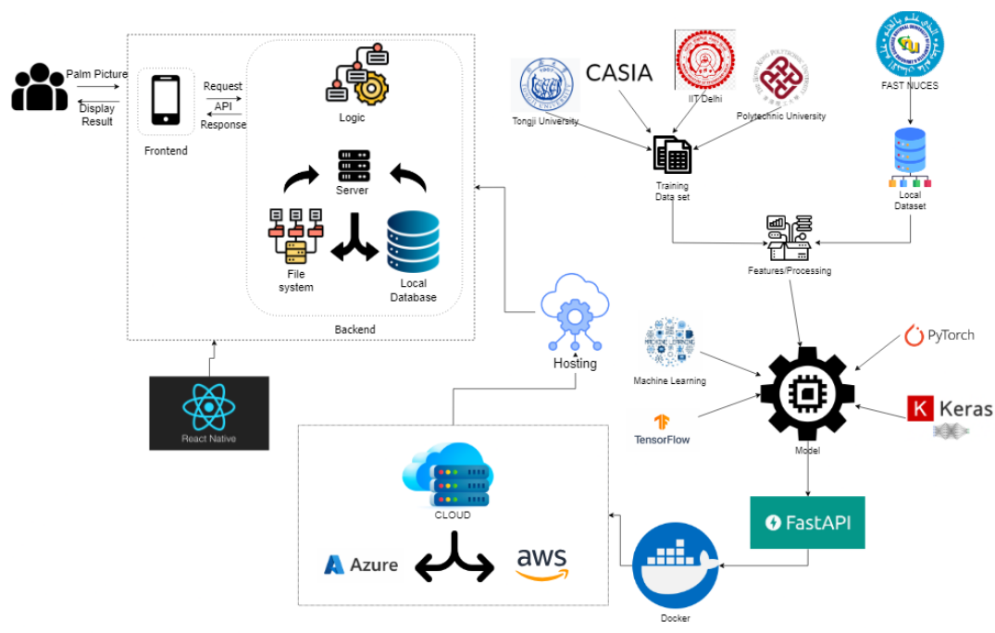
III. Methodology
Computer Science, FAST NUCES
Implementation Methodology
Data Collection: Local dataset and publicly available databases (Tongji Palmprint Database, CASIA Palmprit Dataset, COEP Palmprint Dataset).
Data Augmentation: Techniques like rotation, , and illumination variations to improve robustness.
Model Training
Spatial, Channel, and Multi-Order Competition Modules for feature extraction.
Mobile App Developed using React Native for real-time palmprint verification.
7

Slide 8
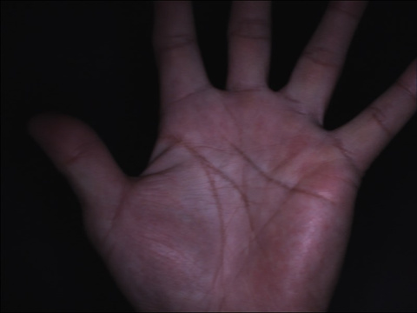
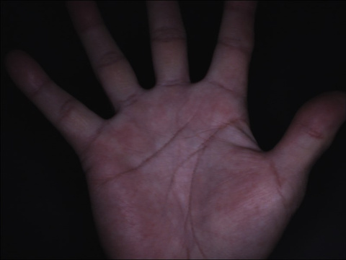
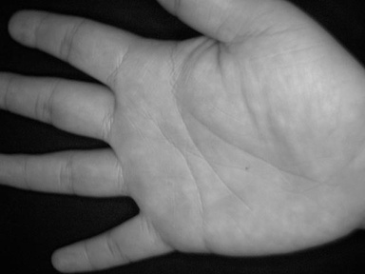
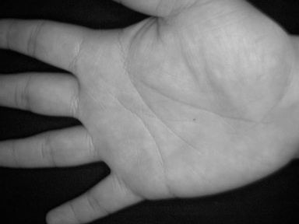
III. Methodology
Computer Science, FAST NUCES
Dataset Details
Tongji Contactless Palmprint Dataset:
12,000 images from 300 individuals
Contactless nature, suitable for hygienic applications
CASIA Palmprint Image Database
5,502 gray-scale images from 312 individuals
Images captured from both left and right palms
Fig 1: A sample Image from Tongji Contactless Palmprint Database
Fig 2: A sample Image from CASIA Palmprint Dataset
8

Slide 9
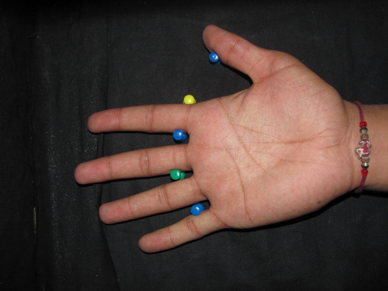
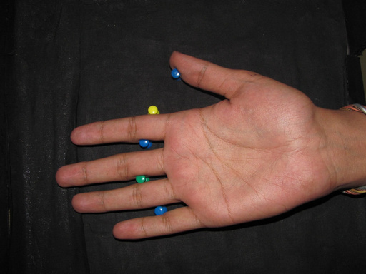
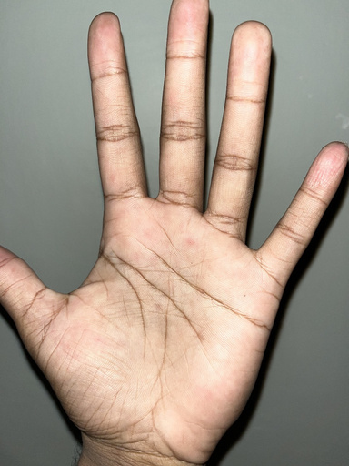
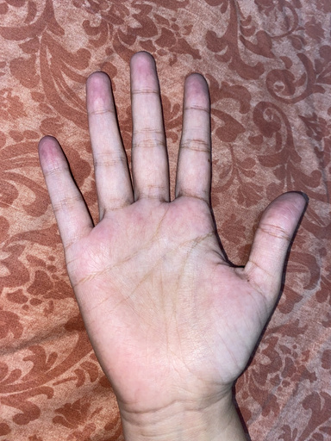
III. Methodology
Computer Science, FAST NUCES
Dataset Details
COEP Palmprint Dataset:
1,344 palmprint images from 168 individuals
Variations in hand orientation and positioning
Locally Collected Dataset:
120 images from 30 users
Variability in image quality, resolution, and environmental conditions
Fig 3: A sample Image from COEP Palmprint Dataset
Fig 4: A sample Image from Locally Collected Palmprint Dataset
8

Slide 10
III. Methodology
Computer Science, FAST NUCES
CCNet Architecture
Our project utilizes the Comprehensive Competition Network (CCNet) for palmprint recognition. The CCNet model integrates multiple competition mechanisms to enhance feature extraction and recognition accuracy.
Key Components:
Learnable Gabor Filters: Automatic adaptation to varying input features.
Spatial Competition Module: Analyzes relationships between different palmprint regions.
Channel Competition Module: Determines dominant texture responses along specific feature channels.
Multi-Order Competition Module: Captures multiscale and higher-order texture features.
Comprehensive Competition Mechanism: Unifies spatial, channel, and multi-order competition mechanisms for efficient feature extraction.
9

Slide 11
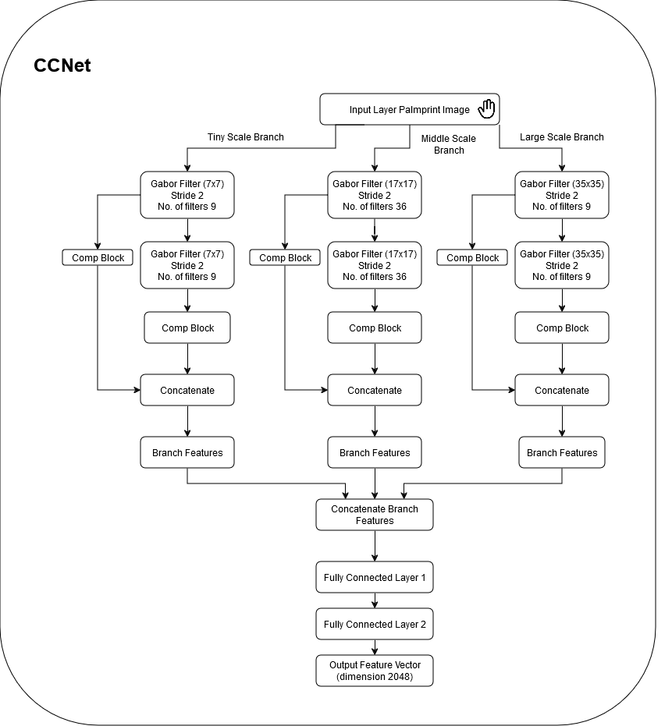
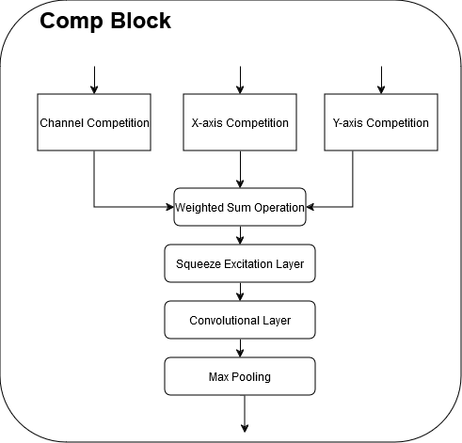
III. Methodology
Computer Science, FAST NUCES
CCNet Architecture
Benefits:
Improved recognition accuracy
Efficient feature extraction
Robustness to varying input features
9

Slide 12
IV. Results
Computer Science, FAST NUCES
Evaluation Metrics for Palmprint Recognition
Key Metrics:
Equal Error Rate (EER): Measures the balance between False Acceptance Rate (FAR) and False Rejection Rate (FRR).
False Acceptance Rate (FAR): Percentage of unauthorized users incorrectly accepted.
False Rejection Rate (FRR): Percentage of legitimate users incorrectly rejected.
Accuracy: Ratio of correctly classified samples to total samples.
Why EER is Preferred Over Accuracy:
EER provides a balanced measure of performance, addressing the trade-off between FAR and FRR.
Accuracy may obscure the trade-offs between FAR and FRR, making EER a more reliable metric for biometric systems.
9

Slide 13
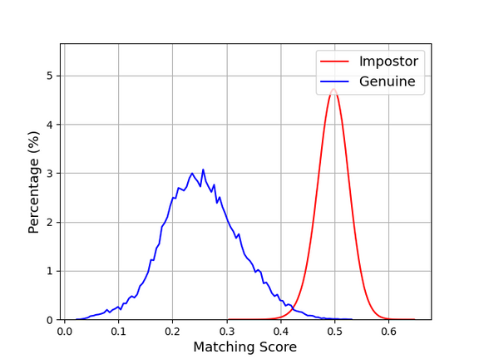
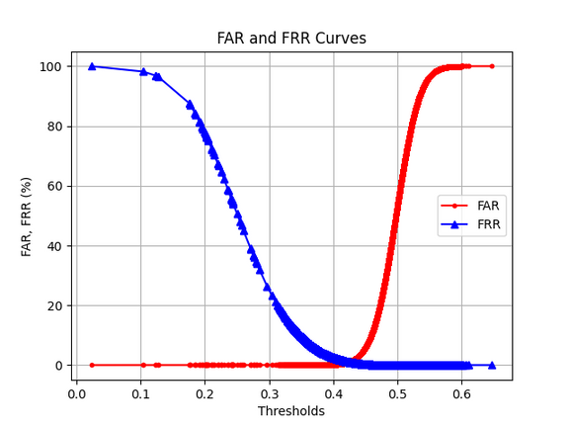
IV. Results
Computer Science, FAST NUCES
Tongji Contactless Palmprint Dataset
Key Performance Indicators:
Equal Error Rate (EER): 0.4%, Testing Accuracy: 94%
Our implementation achieved an EER of 0.4%, closely matching the state-of-the-art performance of CCM. Both methods demonstrated excellent separation in inner-class and outer-class score distributions, indicating effective feature learning and matching. This suggests that both methods are highly accurate in distinguishing between genuine and impostor pairs.
Figure 1: Tongji Dataset Results
9

Slide 14
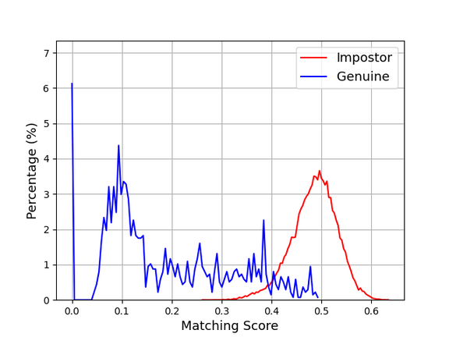
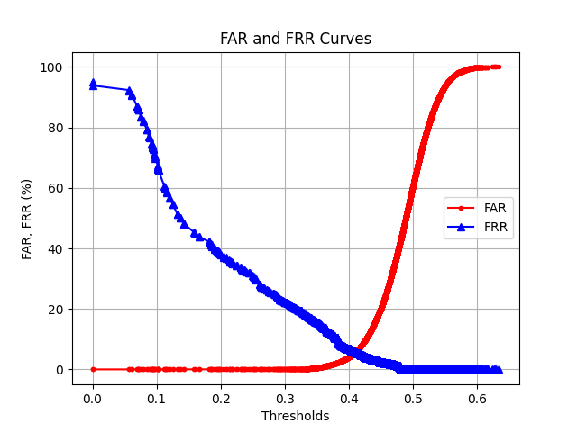
IV. Results
Computer Science, FAST NUCES
COEP Palmprint Dataset:
Key Performance Indicators:
Equal Error Rate (EER): 5.77%, Testing Accuracy: 96%
The CCNet model demonstrated exceptional performance, characterized by a clear separation between inner-class and outer-class scores. This indicates the model's ability to effectively extract discriminative features in contactless palmprint recognition.
Figure 1: COEP Dataset Results
9

Slide 15
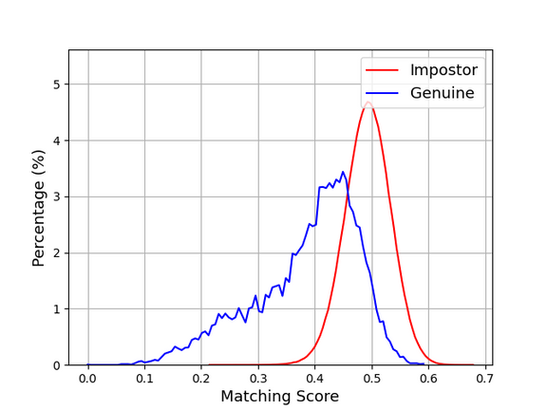
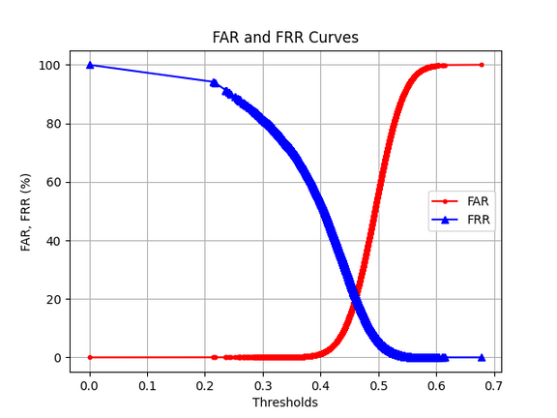
IV. Results
Computer Science, FAST NUCES
CASIA Palmprint Image Database
Key Performance Indicators:
Equal Error Rate (EER): 20%, Testing Accuracy: 84%
Challenges and Future Improvements:
Higher EER indicates challenges in generalization due to intra-class variability and noise.
Potential improvements through dataset-specific tuning of the CCNet architecture.
Figure 1: Casia Dataset Results
9

Slide 16
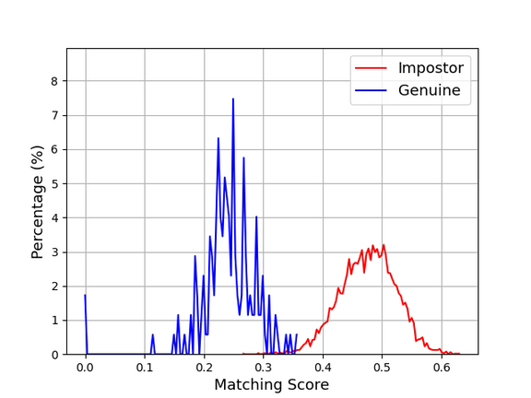
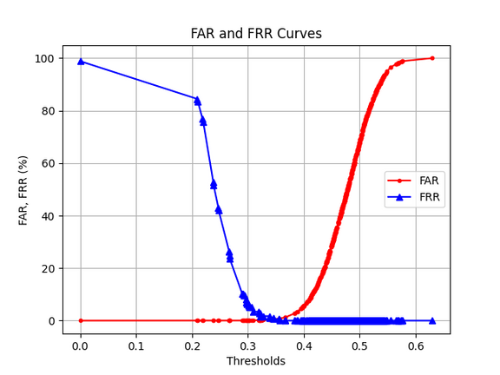
IV. Results
Computer Science, FAST NUCES
Locally Collected Dataset
Key Performance Indicators:
Testing Accuracy: 99%, Equal Error Rate (EER): 0.1%
The CCNet model demonstrated robustness and high reliability in real-world scenarios, achieving impressive results despite variations in image quality. Its adaptability and potential applicability in diverse conditions make it suitable for practical deployment.
Figure 1: Local Dataset Results
9

Slide 17
V. Conclusion & Discussions
Computer Science, FAST NUCES
FYP Phase 1 Deliverables
Data Preparation for Public Datasets: Preparation of public datasets for model training and evaluation, including collection, curation, and preprocessing of the Tongji Contactless Palmprint Dataset, CASIA Palmprint Image Database, and COEP Palmprint Dataset.
Collection and Preparation of Locally Collected Dataset: Gathering and preparation of a diverse and representative dataset of palmprints for model training and evaluation, including data annotation, labeling, and organization.
Development of the CCNet Model: Design and implementation of the CCNet model for palmprint recognition, incorporating spatial, channel, and multi-order competition mechanisms for robust feature extraction.
16

Slide 18
V. Conclusion & Discussions
Computer Science, FAST NUCES
FYP Phase 1 Deliverables
Integration and Training of Datasets: Integration of public and locally collected datasets for training and evaluation of the CCNet model, with a focus on achieving competitive performance metrics such as low Equal Error Rates (EER) and well-separated matching score distributions.
Evaluation of Model Performance: Comprehensive evaluation of the CCNet model's performance using various metrics, including accuracy, loss curves, Matching Score Distribution curves, and FAR-FRR curves.
Preliminary Testing on Locally Collected Dataset: Initial testing of the CCNet model on the locally collected dataset to assess its generalizability to real-world conditions and gather insights into local dataset processing challenges and application-specific performance requirements.
16

Slide 19
V. Conclusion & Discussions
Computer Science, FAST NUCES
FYP Phase 2 Goals
Complete Local Dataset Testing: Finalize dataset collection, conduct extensive evaluations, and identify areas for improvement.
Performance Enhancement Techniques: Implement advanced preprocessing techniques, optimize hyperparameters, and improve accuracy.
Develop Mobile Application (PalmSecure): Design a user-friendly, secure, and efficient mobile app for real-time palmprint recognition, integrating secure data handling and transport infrastructure features.
17

Slide 20
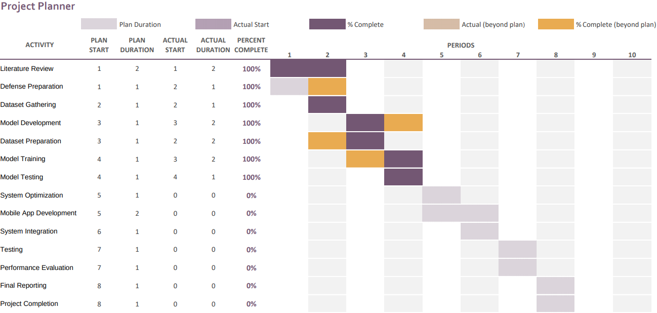
V. Conclusion & Discussions
Computer Science, FAST NUCES
Project Timeline and Key Milestones
14

Slide 21
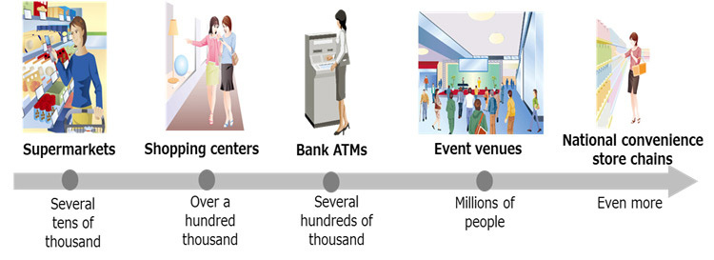
V. Conclusion & Discussions
Department, University
Project Impact
Transport Industry: Improved passenger safety and operational security.
Expansion: Potential applications in banking, ATMs, healthcare, and law enforcement.
11

Slide 22

V. Conclusion & Discussions
Computer Science, FAST NUCES
Sustainable Development Goals
Industry, Innovation, and Infrastructure: Building resilient, secure transport systems.
Sustainable Cities and Communities: Enhancing safety and efficiency.
Peace, Justice, and Strong Institutions: Reducing identity fraud and crime
12

Slide 23
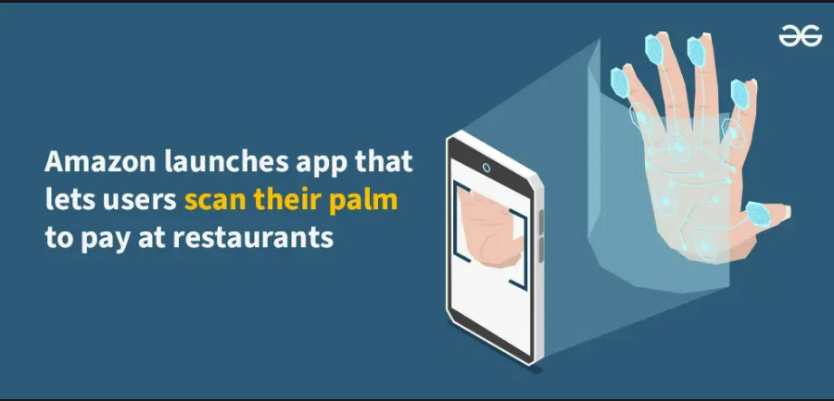
V. Conclusion & Discussions
Computer Science, FAST NUCES
Conclusion
PalmSecure offers a cutting-edge solution to transport security challenges.
Future scalability into various industries, including banking and healthcare.
Comprehensive approach to biometric identity verification using deep learning.
Figure 3: https://www.geeksforgeeks.org/amazon-app-that-lets-users-scan-their-palm-to-pay-at-restaurants/
15

Slide 24
Thursday, 12/12/2024
Computer Science, FAST NUCES
Thank You
For Listening
GROUP MEMBERS
SUPERVISOR
Muhammad Talha Bilal (K21-3349)
Muhammad Hamza (K21-4579)
Muhammad Salar (K21-4619)
Dr. Muhammad Atif Tahir

